Slide 1
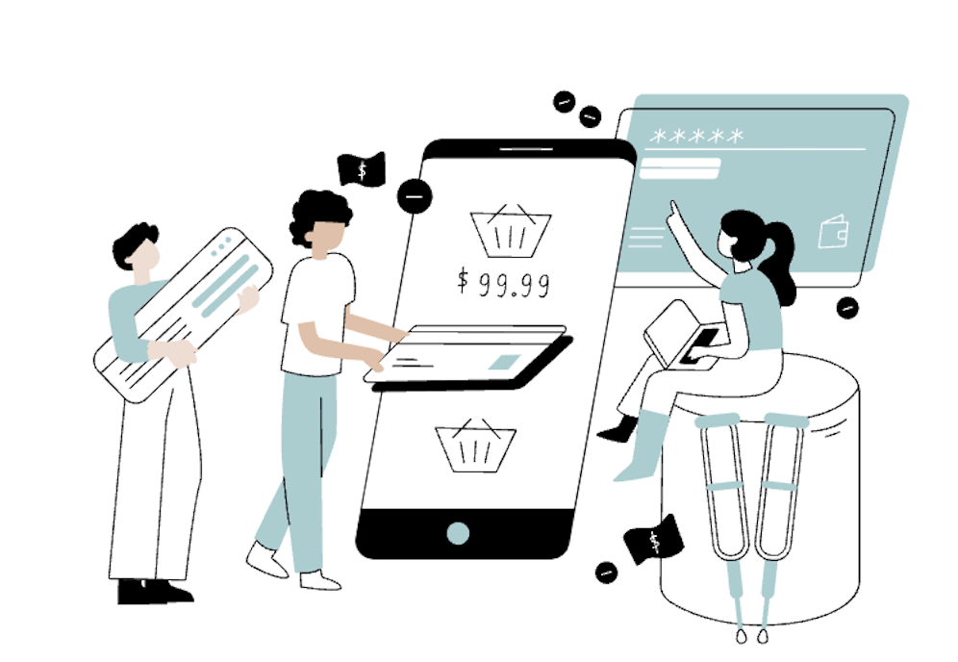
E-commerce Website Database Management
Group 10
Anshita Aishwarya
Vignesh Selvanayagam

Slide 2

Project Objective
In recent times, online retail platforms have gained popularity over traditional stores as the shopping behaviors are changing.
The main objective of our project is to develop an e-commerce platform model for a customer where they can register or buy a product i.e., it allows registered users to view and purchase the required products immediately.
Also, from the supplier’s standpoint, it allows administrators to view order transaction details.
For the project, we have chosen to build the online shopping model for electronics including mobile phones, laptops, monitors, phone accessories, speakers etc.

Slide 3
Database Description
Any user can register on the website and view the available products. Only registered users can purchase the products available. The login user will need to input information such as name, email address, date of birth, phone number, etc.
When a customer makes the first purchase, new information related to the payment such as billing address, shipping address, card and/or bank details, etc., will be added to the database.
Each customer can place several orders at a single time. The customer can add multiple products (at least one) to a shopping cart.
Each order will generate an order items entry which will hold the information of all the products that have been bought in each order being placed.
Each product can be sold by several suppliers. One supplier can be linked to multiple products. The user can choose the supplier’s name while making a purchase.
The products sold on the website will contain information such as item number, name, category, availability in stock or not, customer rating, etc.
Each product will belong to a certain category depending on the type of item being sold. One product can belong to a single category.
Each order can be assigned to a courier service that takes care of shipping the products to the customer.
3 types of roles (supplier, customer, and admins) with different privileges granted will be available on the website.
a. Suppliers are the source of the range of products available.
b. Once the visitor decides to purchase items, they need to register on the website. Such users then become customers.
c. Admins, on the other hand, will have special privileges apart from the other roles. This will include adding new products, editing, or removing available products, marking products as out of stock, etc.

Slide 4
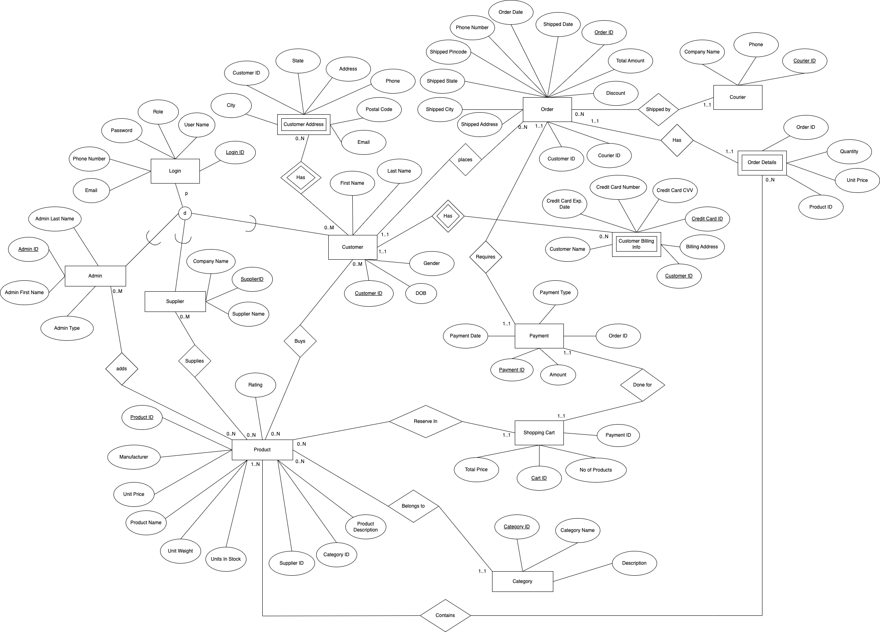
Conceptual Model: EER Diagram

Slide 5
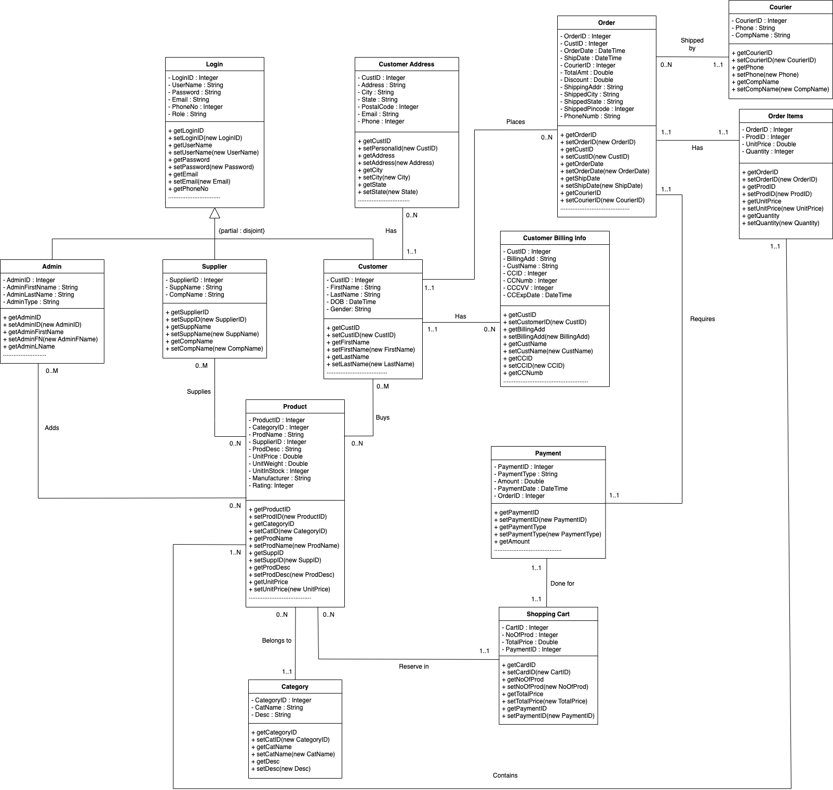
Conceptual Model: UML Diagram

Slide 6
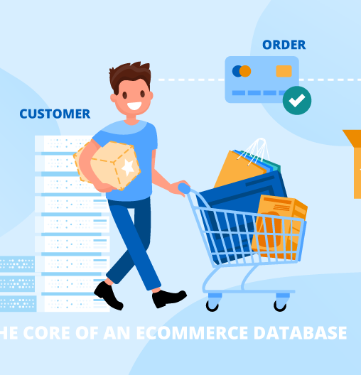
Relational Model
Login (LoginID, Username, Password, PhoneNumber, Email, Role)
Admin (AdminID, AdminFirstName, AdminLastName, AdminType)
Supplier (SupplierID, SupplierName, CompanyName)
Customer (CustomerID, FirstName, DOB, Gender)
CustomerBillingInfo (CreditCardID, CustomerID, CustomerName, CreditCardNo, CreditCardCVV, CreditCardExp, BillingAddress)
adds (AdminID, ProductID)
supplies (SupplierID, ProductID)
buys (CustomerID, ProductID)
CustomerAddress (CustomerID, Address, City, State, PostalCode, Email, Phone)

Slide 7
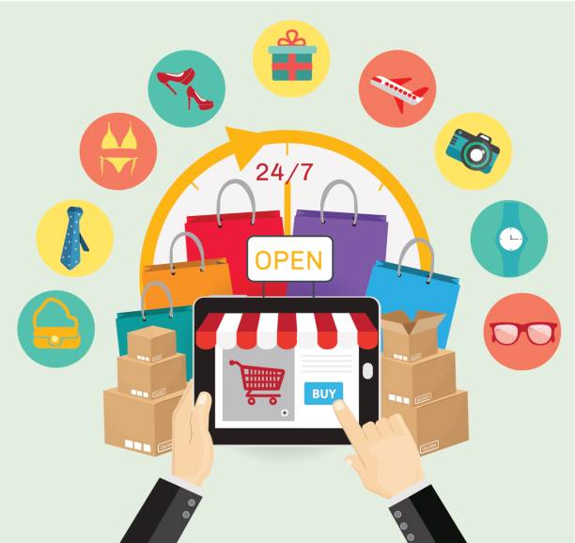
Relational Model
Order (OrderID, OrderDate, CustomerID, TotalAmount, Discount, CourierID, ShippedDate, ShippedAddress, ShippedCity, ShippedState, ShippedPincode, PhoneNumber
Courier (CourierID, CompanyName, Phone)
OrderItems (OrderID, ProductID, Quantity, UnitPrice)
Payment (PaymentID, PaymentType, Amount, PaymentDate, OrderID)
ShoppingCart (CartID, NoOfProducts, TotalPrice, PaymentID)
Product (ProductID, ProductName, Description, UnitPrice, UnitWeight, Manufacturer, UnitsInStock, Rating, CategoryID)
Category (CategoryID, CategoryName, Description)
reserved (CartID, ProductID)

Slide 8
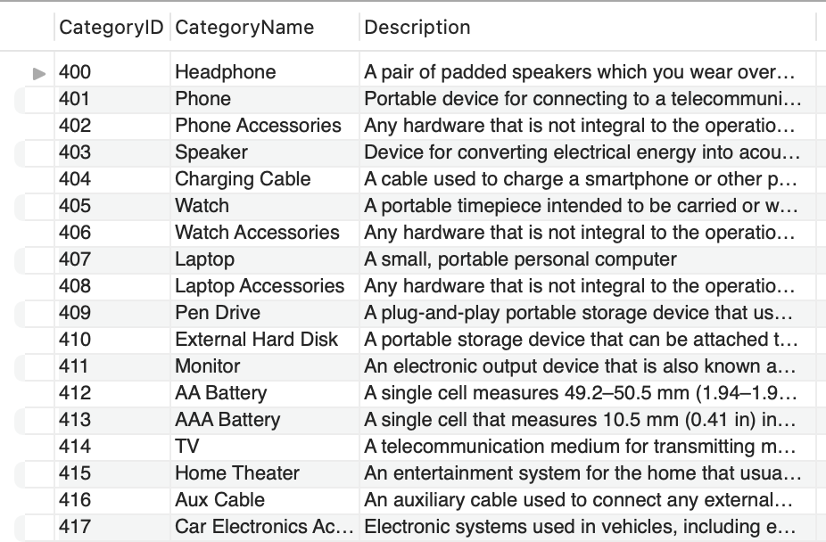
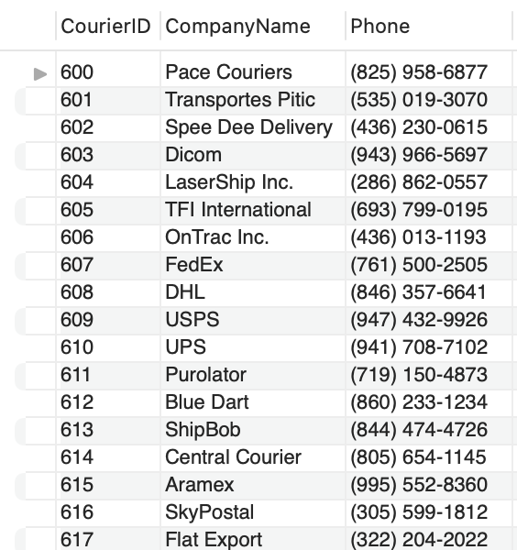
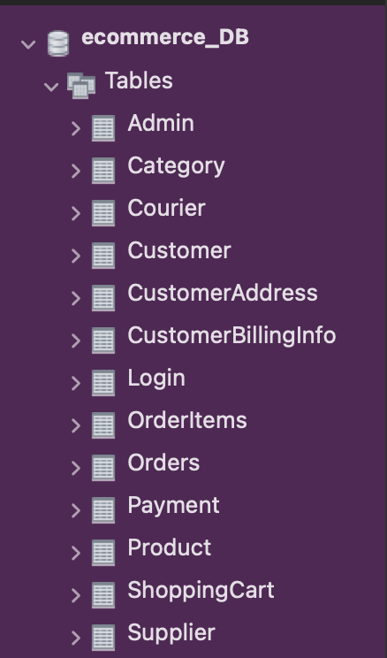
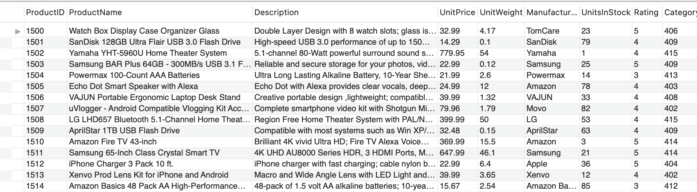
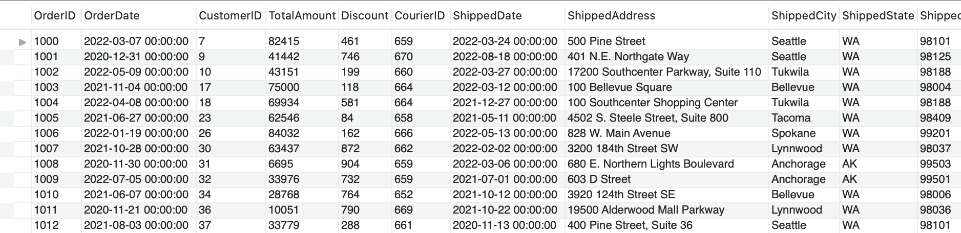
MySQL Implementation

Slide 9
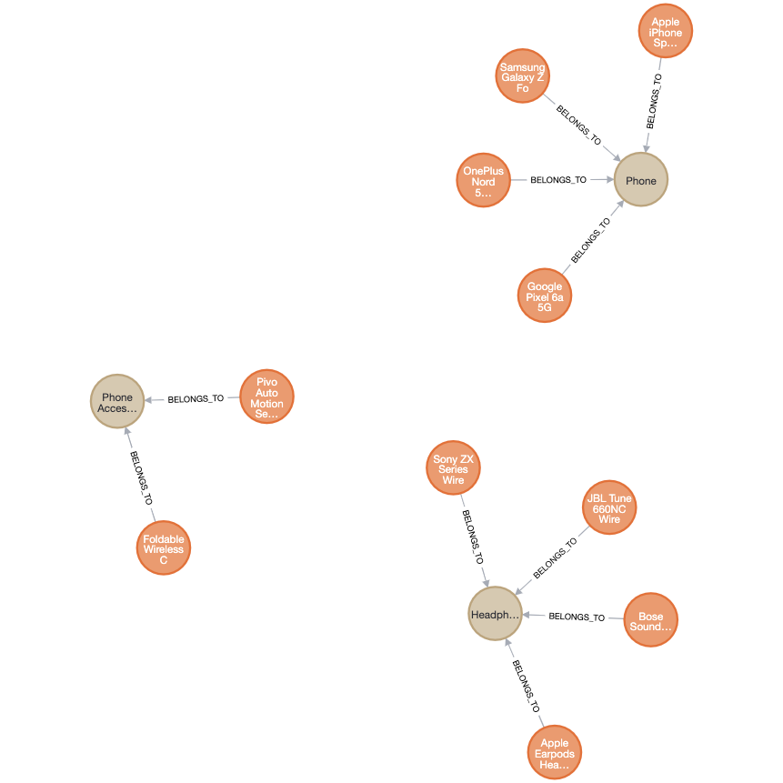
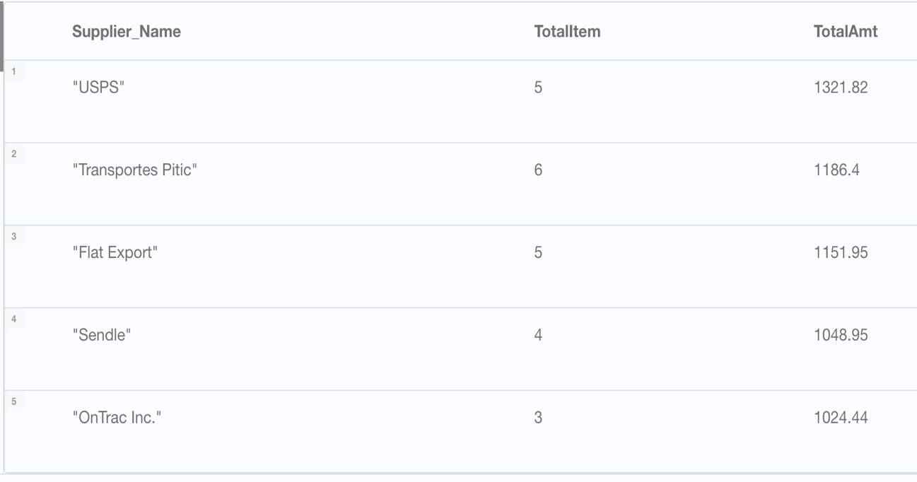
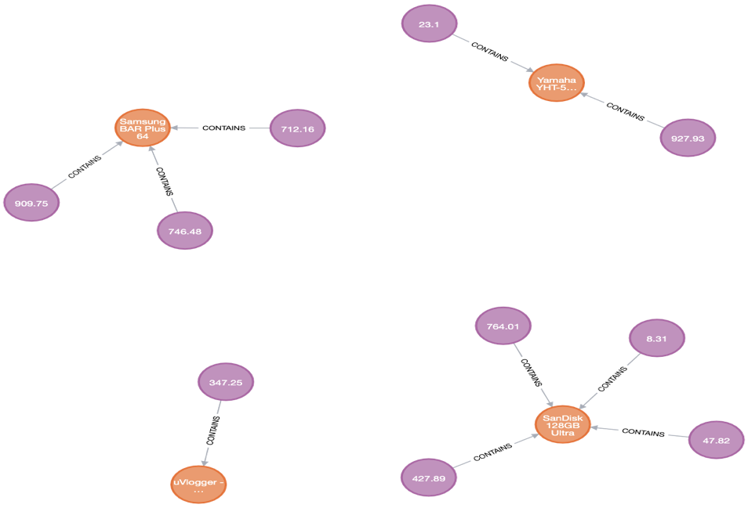
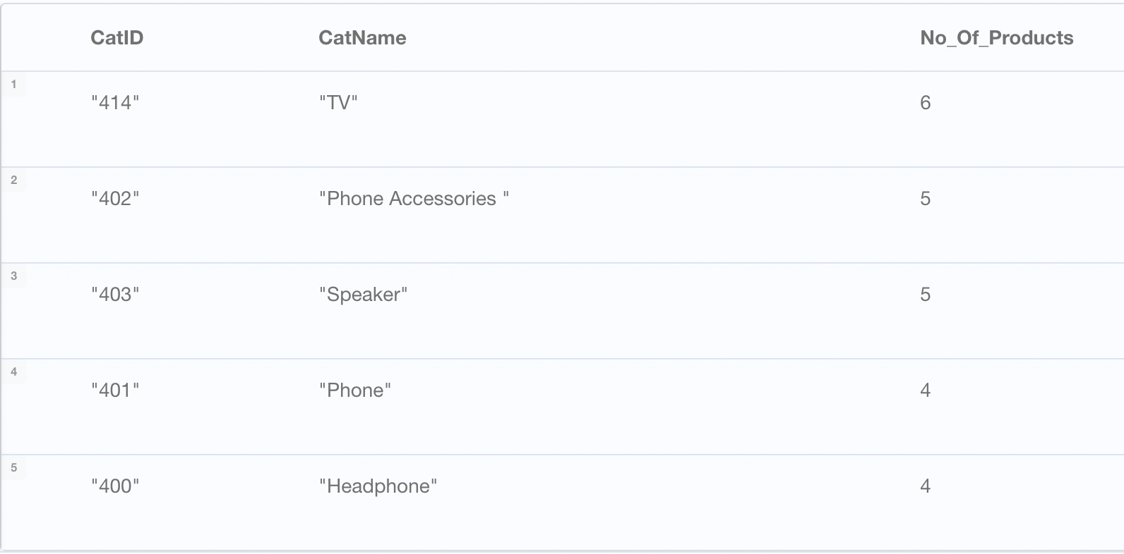
NoSQL Implementation
Customer, Product, Category, Orders, Supplier

Slide 10
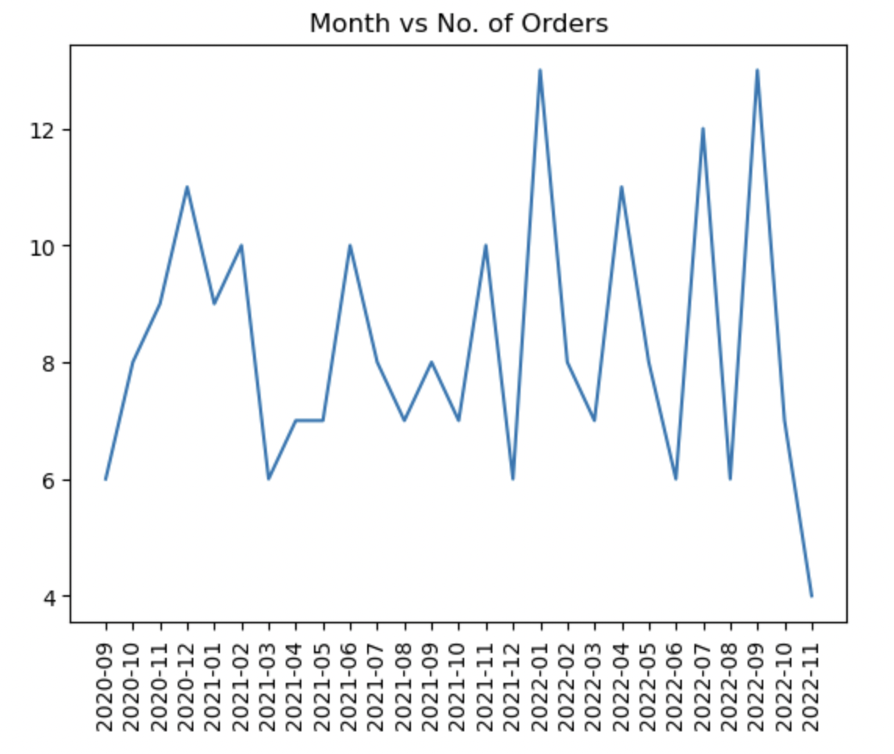
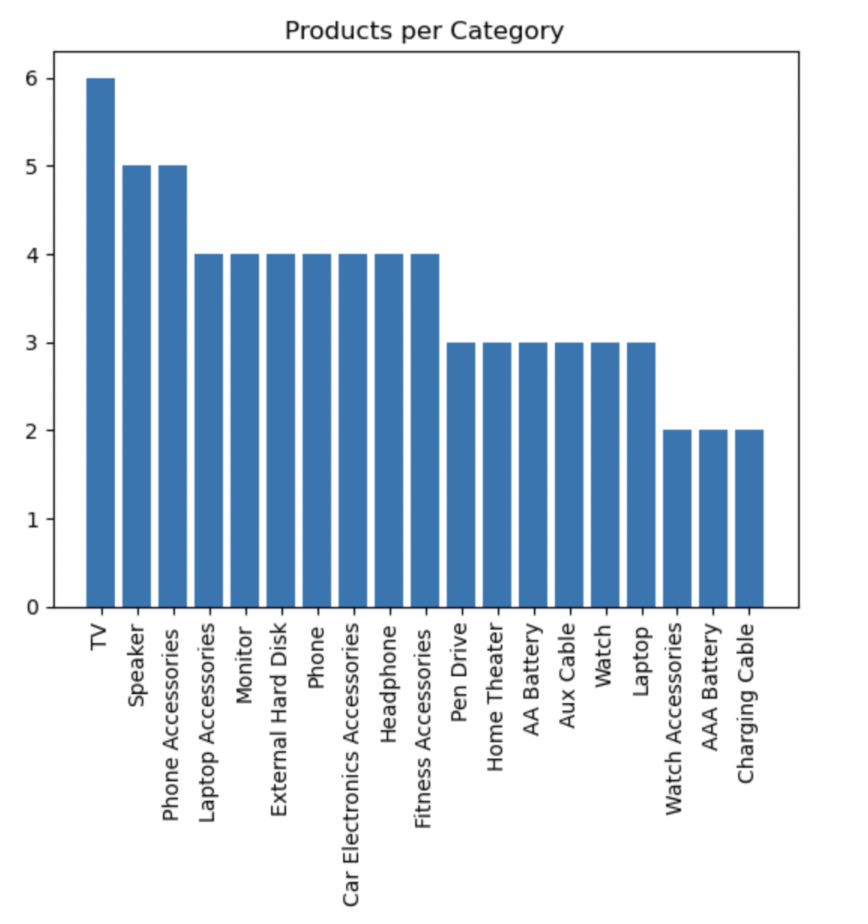
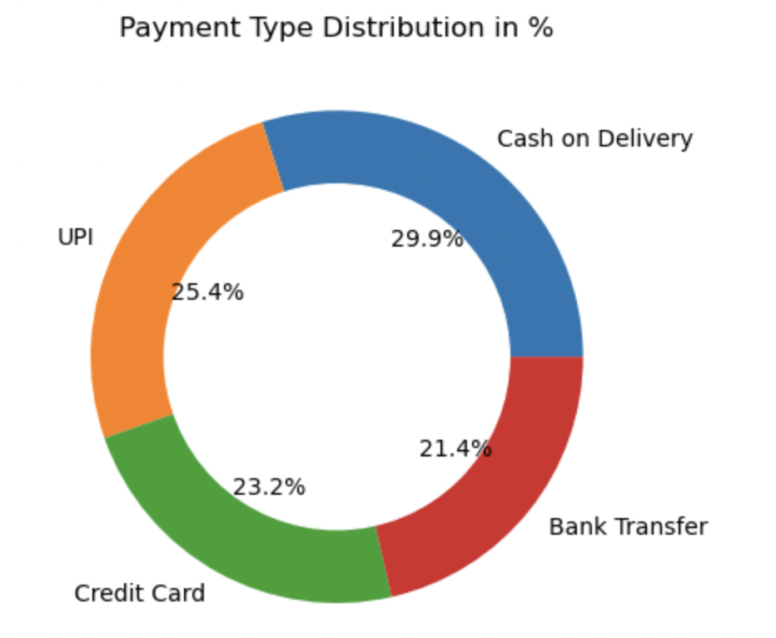
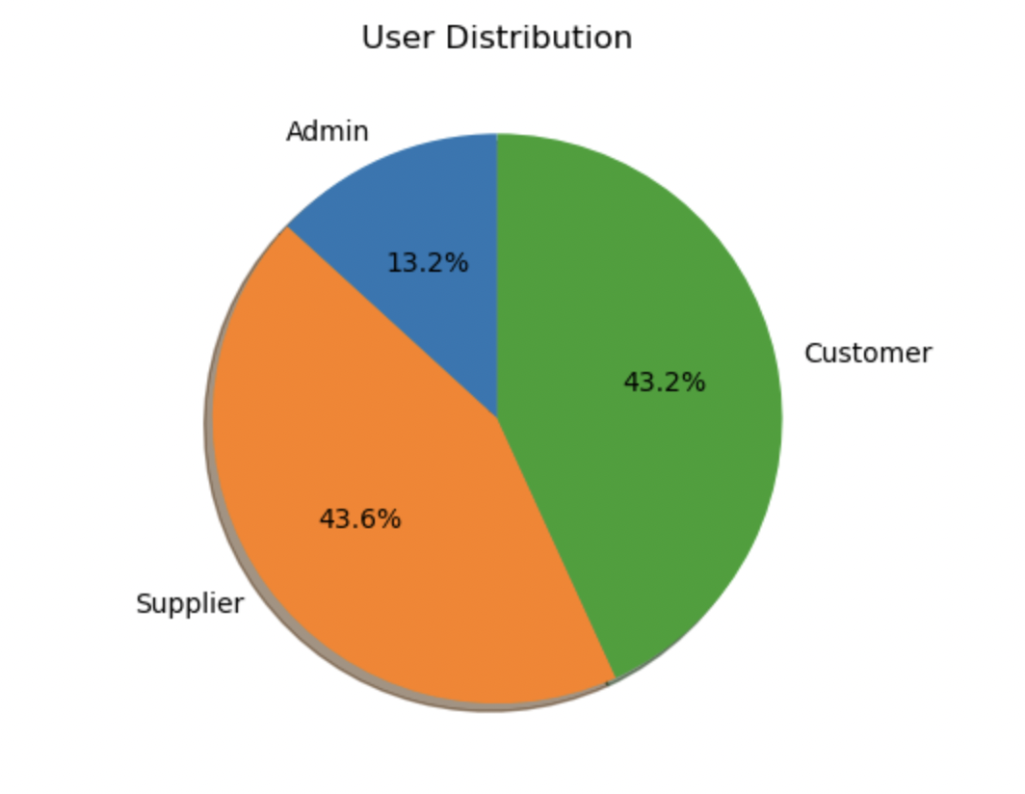
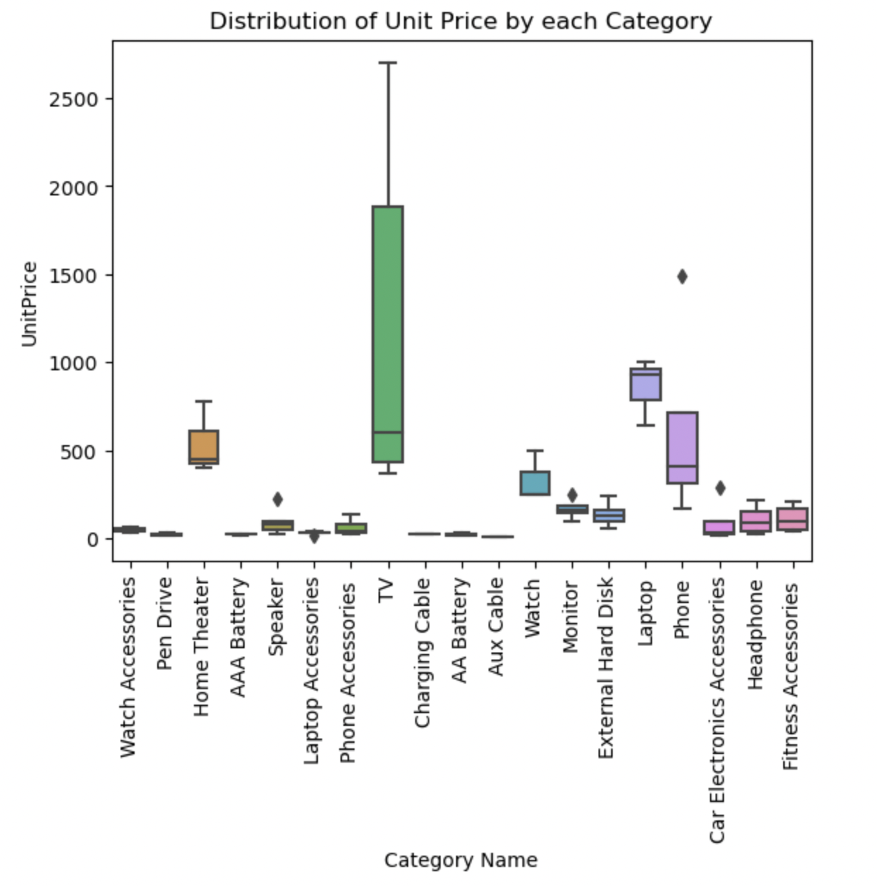
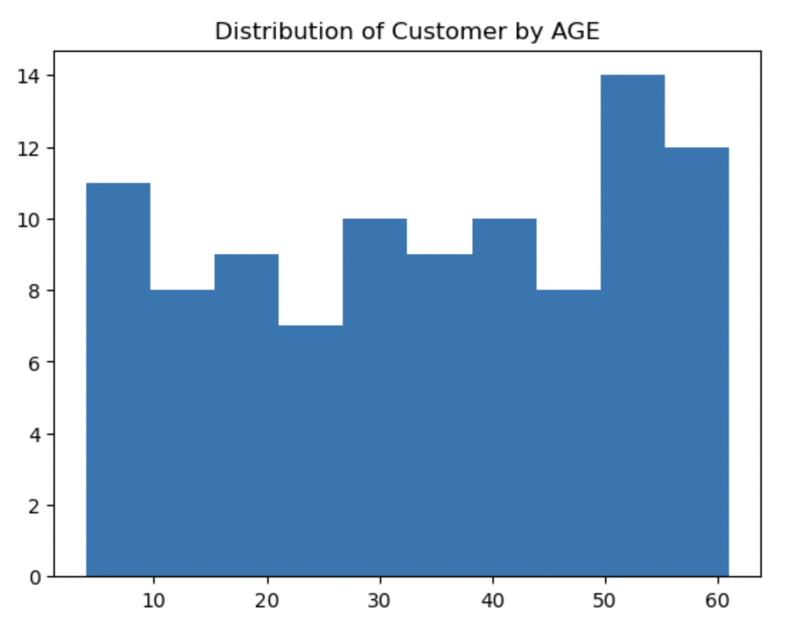
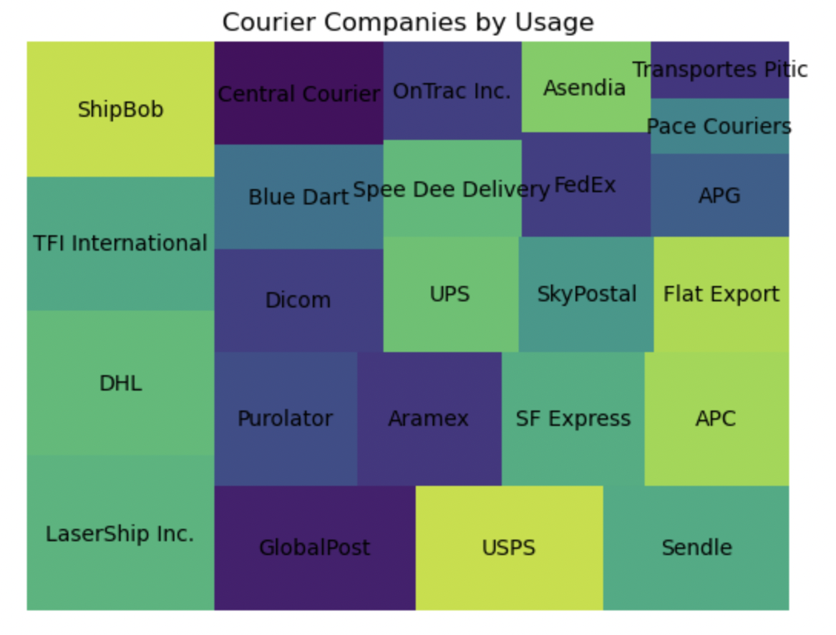
Accessing via Python

Slide 11

Thank You!

